Slide 1

Laptop price

Slide 2
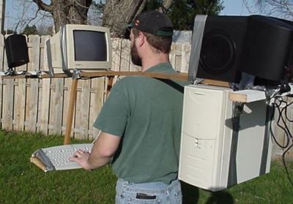
Laptop price prediction
Our goals in this project was to find the most effective features to predict laptop prices

Slide 3
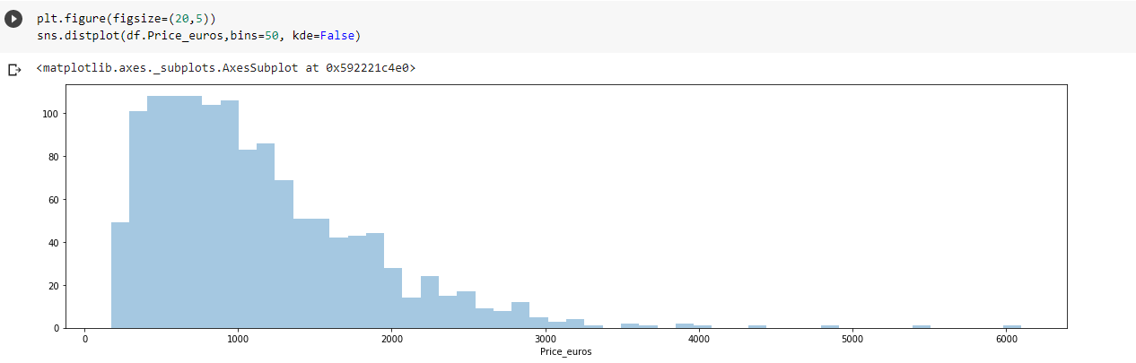
The Dataset
Dataset loaded from Kaggle, contain 1303 records and 12 columns.
https://www.kaggle.com/muhammetvarl/laptop-price
our target variable is laptop price in EUR

Slide 4
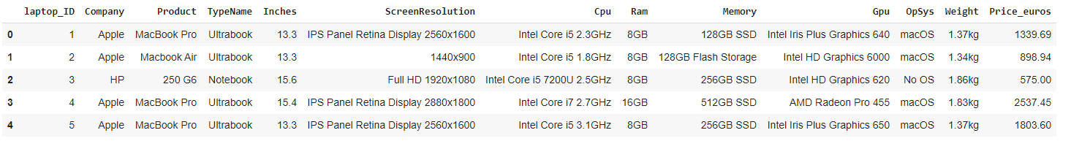
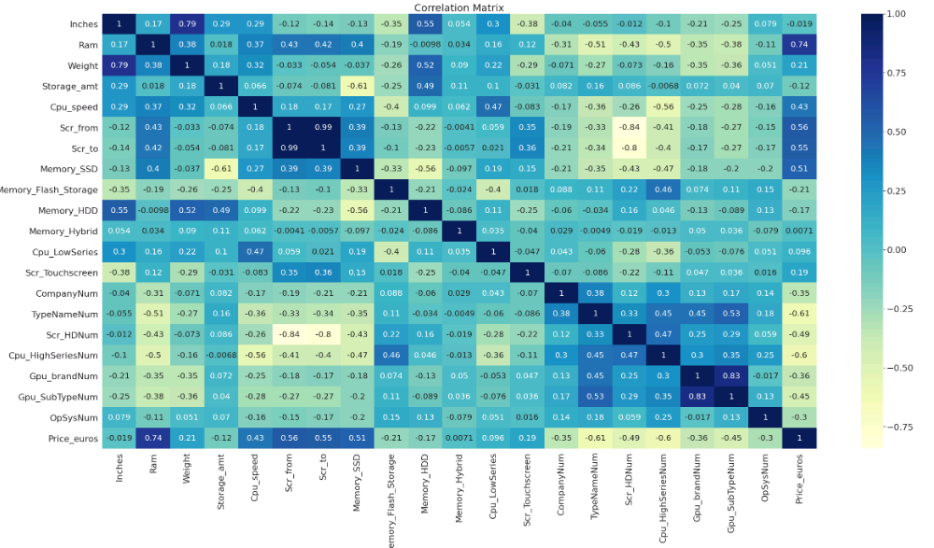
Feature Engineering
Enrichment 20 features from 9 columns using regex and split.
Drop two columns of ID and Product which contain unique value for each row
We approach the solution using two different datasets:
Change categorial features to numeric rank based on avg price.
Use Dummies features (flat binary dataset)

Slide 5
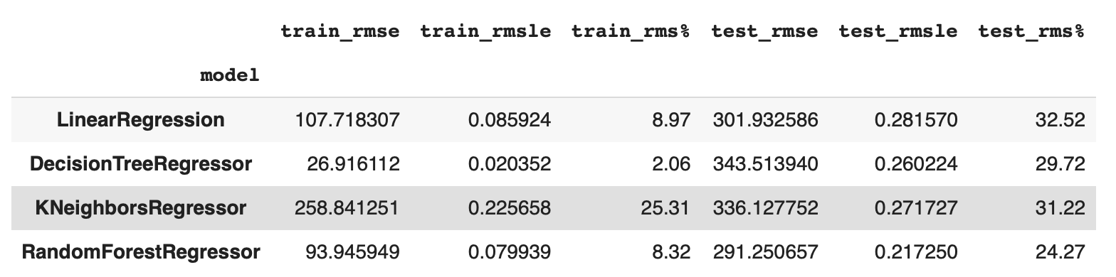
Procedure
Create baseline model for each type of model (DT,LR,KNN,RF) and the most accurate model is RF with RMSE of X

Slide 6
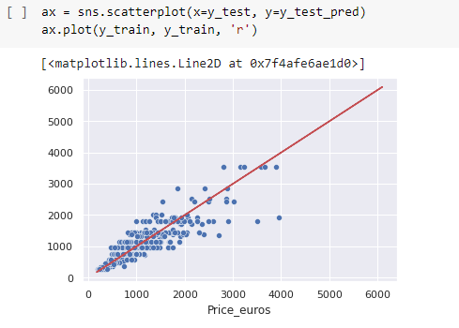
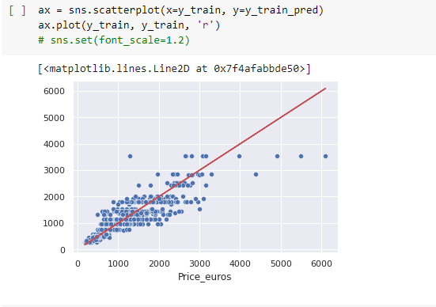
First Run
Our first model runs showed that laptops with price over 3K made noise to the predictions, so we cut out of the dataset the few higher than 3K in price records

Slide 7
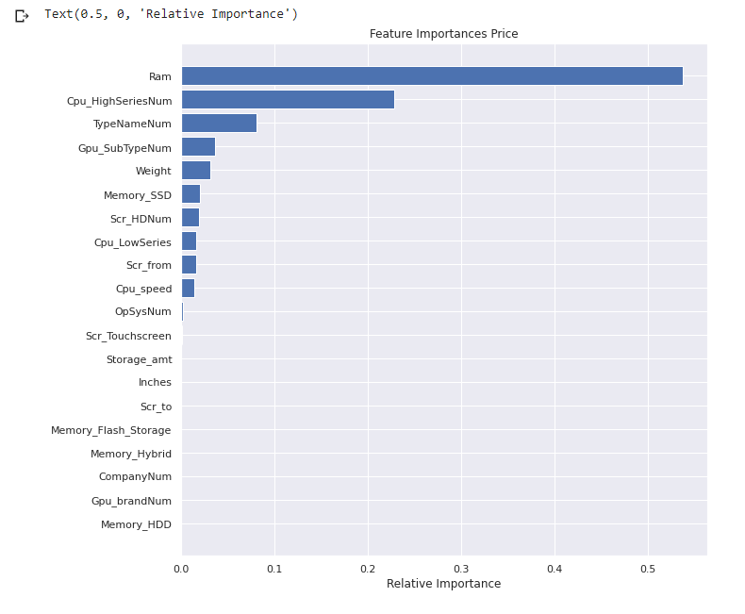
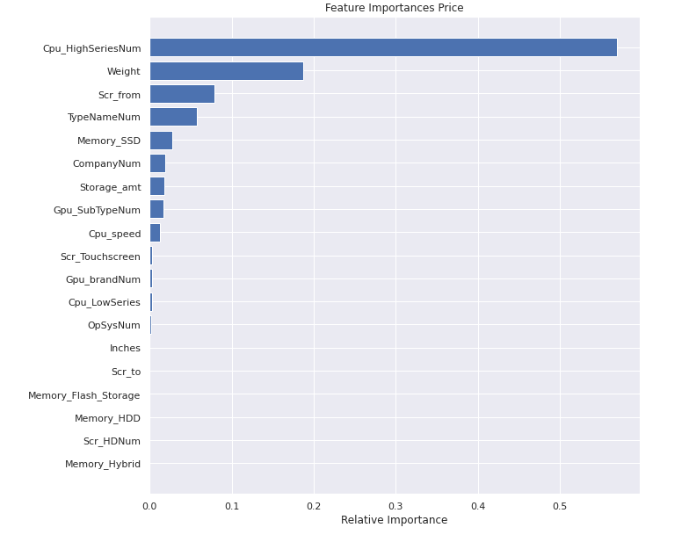
First Run Conclusion
We saw that the most effective feature for the model was RAM memory size
We took it out of the dataset for second run, to see how it will use the other features
The result of the accuracy declined ,so we decided not to drop it from the model.
Before removed Ram
after removed Ram

Slide 8
Using 2 types of dataset conclusions
Both datasets came to same results more or less, with ninor advantage to the categorical dataset
The dataset with the dummies contains 700 features
Feature importance of categorially features as dummies

Slide 9
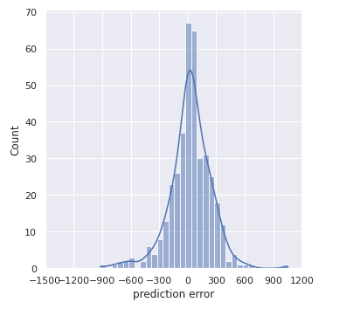
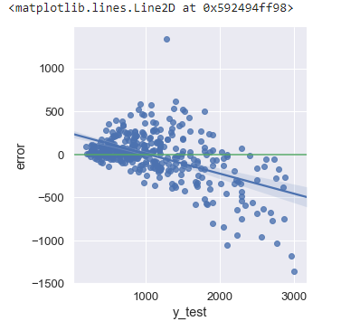
Predictions
Random Forest model made the best predictions, but we did notice that laptops over 1500 EUR, gave worse predictions than the under 1500 EUR

Slide 10
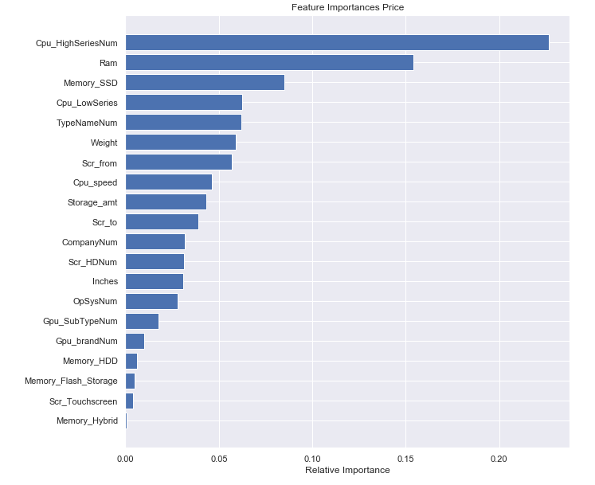
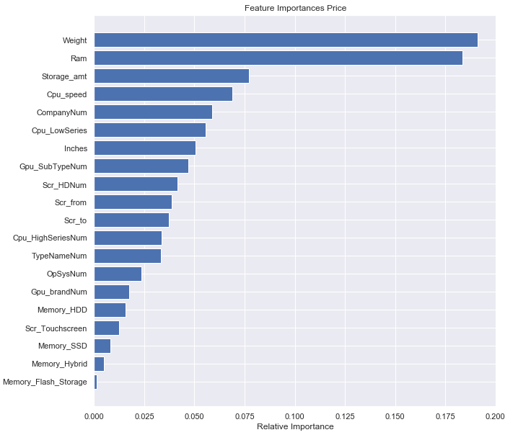
Split
So, we split the dataset to :
Over 1500 EUR price
Under 1500 EUR price
The feature importance support that decision
Laptop price less 1500 EUR
Laptop price over 1500 EUR

Slide 11
Models run results

Slide 12
Summary of done and future
Having Categorical dataset did not affect the result
Even after the dataset split, over 3K prediction was hard to the model
To set Random Forest model hyper-parameters, we used grid search
Use of models we didn’t learn in class
Future – To Do list
Permutation – check the effect of using it
Remove features with high correlation

